Slide 1
Chapter 1
Introduction and Conceptual Modeling

Slide 2
What is DBMS
Database management system is a software which is used to manage the database. For example: MySQL, Oracle, etc are a very popular commercial database which is used in different applications.
DBMS provides an interface to perform various operations like database creation, storing data in it, updating data, creating a table in the database and a lot more.
It provides protection and security to the database. In the case of multiple users, it also maintains data consistency.

Slide 3
Characteristics of DBMS
It uses a digital repository established on a server to store and manage the information.
It can provide a clear and logical view of the process that manipulates data.
DBMS contains automatic backup and recovery procedures.
It contains ACID properties which maintain data in a healthy state in case of failure.
It can reduce the complex relationship between data.
It is used to support manipulation and processing of data.
It is used to provide security of data.
It can view the database from different viewpoints according to the requirements of the user.

Slide 4
Advantages of DBMS
Controls database redundancy: It can control data redundancy because it stores all the data in one single database file and that recorded data is placed in the database.
Data sharing: In DBMS, the authorized users of an organization can share the data among multiple users.
Easily Maintenance: It can be easily maintainable due to the centralized nature of the database system.
Reduce time: It reduces development time and maintenance need.
Backup: It provides backup and recovery subsystems which create automatic backup of data from hardware and software failures and restores the data if required.
Multiple user interface: It provides different types of user interfaces like graphical user interfaces, application program interfaces

Slide 5
Disadvantages of DBMS
Cost of Hardware and Software: It requires a high speed of data processor and large memory size to run DBMS software.
Size: It occupies a large space of disks and large memory to run them efficiently.
Complexity: Database system creates additional complexity and requirements.
Higher impact of failure: Failure is highly impacted the database because in most of the organization, all the data stored in a single database and if the database is damaged due to electric failure or database corruption then the data may be lost forever.

Slide 6
DBMS Architecture
The DBMS design depends upon its architecture.
The basic client/server architecture is used to deal with a large number of PCs, web servers, database servers and other components that are connected with networks.
The client/server architecture consists of many PCs and a workstation which are connected via the network.
DBMS architecture depends upon how users are connected to the database to get their request done

Slide 7
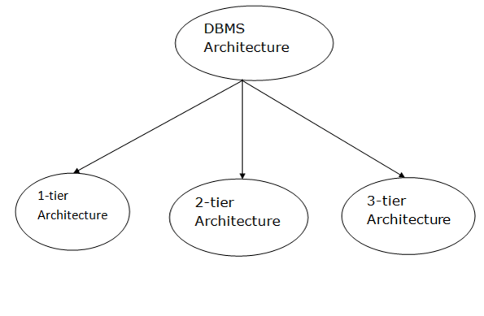
DBMS Architecture

Slide 8
Types of Architecture
Database architecture can be seen as a single tier or multi-tier. But logically, database architecture is of two types like: 2-tier architecture and 3-tier architecture.
1-Tier Architecture
In this architecture, the database is directly available to the user. It means the user can directly sit on the DBMS and uses it.
Any changes done here will directly be done on the database itself. It doesn't provide a handy tool for end users.

Slide 9
2-Tier Architecture
The 2-Tier architecture is same as basic client-server.
In the 2-tier architecture, applications on the client end can directly communicate with the database at the server side. For this interaction, API's like: ODBC, JDBC are used.
The user interfaces and application programs are run on the client-side.
The server side is responsible to provide the functionalities like: query processing and transaction management.
To communicate with the DBMS, client-side application establishes a connection with server side.

Slide 10
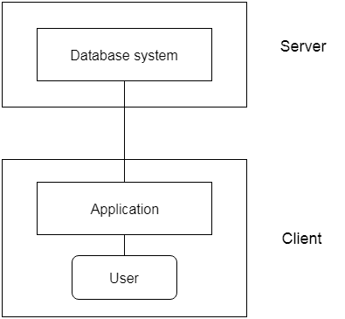
2-Tier Architecture

Slide 11
3-Tier Architecture
The 3-Tier architecture contains another layer (Application Layer) between the client and server.
In this architecture, client can't directly communicate with the server.
The application on the client-end interacts with an application server which further communicates with the database system.
End user has no idea about the existence of the database beyond the application server. The database also has no idea about any other user beyond the application.

Slide 12
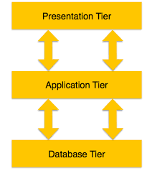
3-Tier Architecture

Slide 13
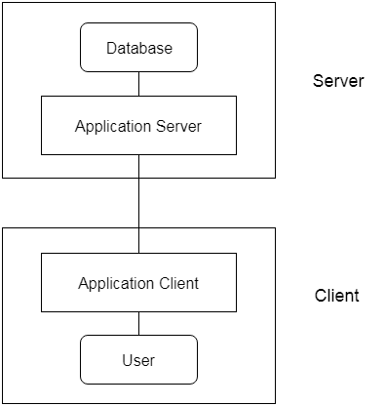
3-Tier Architecture

Slide 14
3-Tier Architecture
Presentation Tier: Occupies the top level and displays information related to services available on a website. This tier communicates with other tiers by sending results to the browser and other tiers in the network.
Application Tier: Also called the middle tier, logic tier, business logic or logic tier. It controls application functionality by performing detailed processing.
Data Tier: Houses database servers where information is stored and retrieved. Data in this tier is kept independent of application servers or business logic.

Slide 15
3-Schema/Level Architecture
Data Abstraction – 3 Levels
This framework is used to describe the structure of a specific database system.
The three schema architecture is also used to separate the user applications and physical database.
The three schema architecture contains three-levels. It breaks the database down into three different categories.

Slide 16
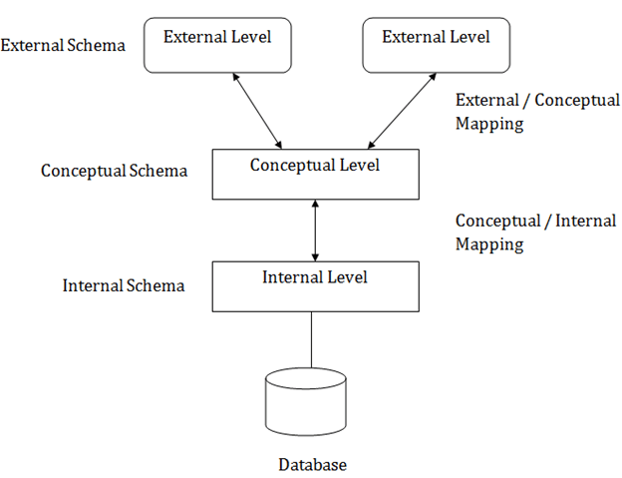
3-Schema/Level Architecture

Slide 17
3-Schema/Level Architecture
Mapping is used to transform the request and response between various database levels of architecture. In External / Conceptual mapping, it is necessary to transform the request from external level to conceptual schema. In Conceptual / Internal mapping, DBMS transform the request from the conceptual to internal level.

Slide 18
Internal Level
The internal level has an internal schema which describes the physical storage structure of the database.
The internal schema is also known as a physical schema.
It uses the physical data model. It is used to define that how the data will be stored in a block.
The physical level is used to describe complex low-level data structures in detail.

Slide 19
Conceptual Level
The conceptual schema describes the design of a database at the conceptual level. Conceptual level is also known as logical level.
The conceptual schema describes the structure of the whole database. It describes what data are to be stored in the database and also describes what relationship exists among those data.
In this level, internal details such as an implementation of the data structure are hidden.
Programmers and database administrators work at this level.

Slide 20
External/View Level
At the external level, a database contains several schemas that sometimes called as subschema. The subschema is used to describe the different view of the database.
An external schema is also known as view schema.
Each view schema describes the database part that a particular user group is interested and hides the remaining database from that user group. The view schema describes the end user interaction with database systems.

Slide 21
Schema and Instance
Instance : The data which is stored in the database at a particular moment of time is called an instance of the database.
Schema : The overall design of a database is called schema. A database schema is the skeleton structure of the database. It represents the logical view of the entire database.

Slide 22
Data Independence
Data independence refers ability to modify the schema at one level of database system without changing the schema at next higher level.
When a schema at a lower level is changed, only the mappings between this schema and higher-level schemas need to be changed in a DBMS that fully supports data independence.
The higher-level schemas themselves are unchanged.
Hence, the application programs need not be changed since they refer to the external schemas.

Slide 23
Types of Data Independence
There are two types of data independence:
Physical Data Independence
Logical Data Independence

Slide 24
Physical Data Independence
Physical data independence can be defined as the capacity to change the internal schema without having to change the conceptual schema.
If we do any changes in the storage size of the database system server, then the Conceptual structure of the database will not be affected.
Physical data independence is used to separate conceptual levels from the internal levels.
Physical data independence occurs at the logical interface level.

Slide 25
Logical Data Independence
Logical data independence refers characteristic of being able to change the conceptual schema without having to change the external schema.
Logical data independence is used to separate the external level from the conceptual view.
If we do any changes in the conceptual view of the data, then the user view of the data would not be affected.
Logical data independence occurs at the user interface level.

Slide 26
Data Definition Language - DDL
DDL stands for Data Definition Language. It is used to define database structure or pattern.
It is used to create schema, tables, indexes, constraints, etc. in the database.
Using the DDL statements, you can create the skeleton of the database.
Data definition language is used to store the information of metadata like the number of tables and schemas, their names, indexes, columns in each table, constraints, etc.

Slide 27
Data Definition Language - DDL
Create: It is used to create objects in the database.
Alter: It is used to alter the structure of the database.
Drop: It is used to delete objects from the database.
Truncate: It is used to remove all records from a table.
Rename: It is used to rename an object.
Comment: It is used to comment on the data dictionary.

Slide 28
Data Manipulation Language - DML
DML stands for Data Manipulation Language.
It is used for accessing and manipulating data in a database. It handles user requests.
Here are some tasks that come under DML:
Select: It is used to retrieve data from a database.
Insert: It is used to insert data into a table.
Update: It is used to update existing data within a table.
Delete: It is used to delete all records from a table.

Slide 29
Data Dictionary / Repository
A data dictionary is a file or a set of files that contains a database's metadata (Data about Data).
It is a crucial component of any relational database.
It contains records about other objects in the database, such as data ownership, data relationships to other objects, and other data.
It is used to store schema descriptions and other information such as design decisions, application program descriptions, user information, usage standards, etc.

Slide 30
Classification of DBMS
Based on the data model :
Traditional:
Relational,
Network,
Hierarchical
Emerging:
Object-oriented
Object-relational

Slide 31
Classification of DBMS
Based on number of users :
Single user –
It support only one user at a time.
It is mostly used with the personal computer on which the data resides accessible to a single person.
The user may design, maintain and write the database programs.
Multiple users –
It supports multiple users concurrently.
Data can be integrated

Slide 32
Classification of DBMS
Based on the sites over which network is distributed :
Centralized database system – The DBMS and data are stored at the single site that is used by several other systems too. We can simply say that data here is maintained on the centralized server.
Parallel network database system – This system has the advantage of improving processing input and output speeds. Majorly used in the applications that have query to larger database. It holds the multiple central processing units and data storage disks in parallel.
Distributed database system – In this data and the DBMS software are distributed over several sites but connected to the single computer.

Slide 33
Classification of DBMS
Distributed database system are of two types :
Homogeneous DBMS
They use same software but from the multiple sites.
Data exchange between the sites can be handled easily.
Heterogeneous DBMS
They use different DBMS software for different sites but there is a additional software that helps the exchange of the data between the sites.

Slide 34
Classification of DBMS
Client-server database system
This system has two logical components namely client and server.
Clients are generally the personal computers or workstations whereas servers are the large workstations, mini range computers or a main frame computer system.
The applications and tools of the DBMS run on the client platforms and the DBMS software on the server.
Multi-tier client-server database system
The rise of personal computers in business has increased the reliability of the network hardware leading to evolution of two-tier and three-tier systems which use different software for the client and server.

Slide 35
Data Models
Underlying the structure of a Database is a Data Model. A Database model defines the logical design and structure of a database. It defines how data will be stored, accessed and updated in a database management system.
The very first data model could be flat data-models, where all the data used are to be kept in same plane. Earlier data models were not so scientific, hence they have lots of duplication and update anomalies. Relational Model is the most widely used database model. However, there are other models too:

Slide 36
Types of Data Models
Hierarchical Model
Network Model
Entity-relationship [ER] Model
Relational Model
Object-oriented Data Models
Object-Relational Models

Slide 37
Hierarchical Models
This model organizes data into a tree-like-structure, with a single root, to which all other data is linked.
The hierarchy starts from the Root data, and expands like a tree, adding child nodes to the parent nodes.
This model efficiently describes many real-world relationships like index of a book, recipes etc.
In hierarchical model, there is one-to-many relationship between two different types of data.
For example, one department can have many courses, many professors and of-course many students.

Slide 38
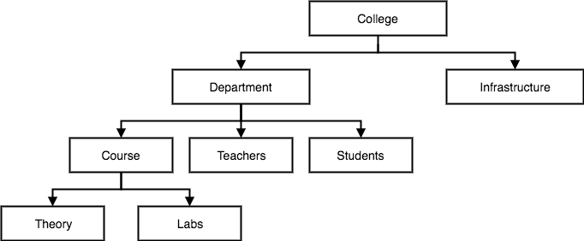
Hierarchical Models

Slide 39
Hierarchical Model
Advantages
Simple to construct and operate
Corresponds to a number of natural hierarchically organized domains, e.g., organization (“org”) chart
Language used is simple
Uses constructs like GET, GET UNIQUE, GET NEXT, GET NEXT WITHIN PARENT, etc.
Disadvantages
Navigational and procedural nature of processing
DB is visualized as a linear arrangement of records
Little scope for "query optimization"

Slide 40
Network Models
This is an extension of the Hierarchical model.
In this model data is organized more like a graph, and are allowed to have more than one parent node.
The data is more related as more relationships are established in this model. Thus, data is also easier and fast. This database model used to map many-to-many data relationships. This was the most widely used database model, before Relational Model was introduced

Slide 41
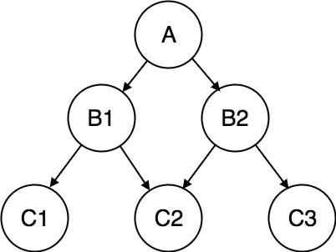
Network Data Model

Slide 42
Network Model
Advantages
Network Model is able to model complex relationships and represents semantics of add/delete on the relationships.
Can handle most situations for modeling using record types and relationship types. Language is navigational; uses constructs like FIND, FIND member, FIND owner, FIND NEXT within set, GET, etc. Programmers can do optimal navigation through the database.
Disadvantages
Navigational and procedural nature of processing. Database contains a complex array of pointers that thread through a set of records. Little scope for automated “query optimization”

Slide 43
ER Data Model
In this model, relationships are created by dividing object of interest into entity and its characteristics into attributes.
Different entities are related using relationships.
E-R Models are defined to represent the relationships into pictorial form to make it easier for different stakeholders to understand.
This model is good to design a database, which can then be turned into tables in relational model.
E.g. If we have to design a School Database, then Student will be an entity with attributes name, age, address etc. As Address is generally complex, it can be another entity with attributes street name, pincode, city etc, and there will be a relationship between them.
Relationships can also be of different types.

Slide 44
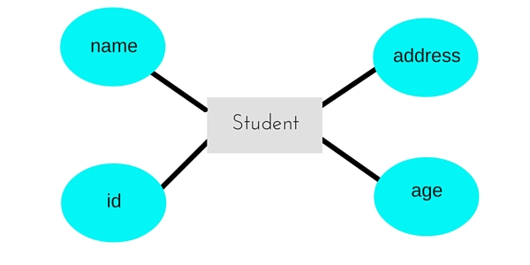
ER Data Model

Slide 45
ER Data Model
Advantages
Straightforward relation representation: Having designed an E-R diagram for a database application, the relational representation of the database model becomes relatively straightforward.
Easy conversion for E-R to other data model: Conversion from E-R diagram to a network or hierarchical data model can· easily be accomplished.
Graphical representation for better understanding: An E-R model gives graphical and diagrammatical representation of various entities, its attributes and relationships between entities. This is turn helps in the clear understanding of the data structure and in minimizing redundancy and other problems.
Disadvantages
No industry standard for notation: There is no industry standard notation for developing an E-R diagram.
Popular for high-level design: The E-R data model is especially popular for high level.

Slide 46
Relational Model
Most widely used Data Model
Proposed in 1970 by E.F. Codd (IBM), first commercial system in 1981-82.
Now in several commercial products (e.g. DB2, ORACLE, MS SQL Server, SYBASE, INFORMIX).
Several free open source implementations, e.g. MySQL, PostgreSQL
Currently most dominant for developing database applications.
SQL relational standards: SQL-89 (SQL1), SQL-92 (SQL2), SQL-99, SQL3, …

Slide 47
Relational Model
In this model, data is organized in two-dimensional tables and the relationship is maintained by storing a common field.
This model was introduced by E.F Codd in 1970, and since then it has been the most widely used database model, infact, we can say the only database model used around the world.
The basic structure of data in the relational model is tables. All the information related to a particular type is stored in rows of that table.
Hence, tables are also known as relations in relational model.

Slide 48
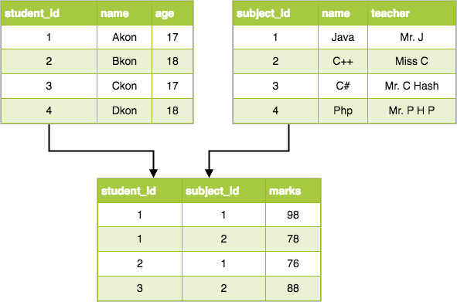
Relational Data Model

Slide 49
Relational Model
Advantages
Simplicity and Easy to Use : A relational data model is simpler than the hierarchical and network model. Uses Tables which easy to deal with. Structural Independence: Relational database is only concerned with data and not with structure. This improves the performance of model.
Query capability: It makes possible for a high-level query language like SQL to avoid complex database navigation.
Data independence: The structure of a database can be changed without having to change any application.
Scalable: Regarding a number of records, or rows, and the number of fields, a database should be enlarged to enhance its usability.
Disadvantages
Few databases have limits on field lengths which can't be exceeded. Relational DBs can sometimes become complex as amount of data grows, and relations between pieces of data become more complicated. Complex relational database systems may lead to isolated databases where the information cannot be shared from one system to another.

Slide 50
Object-oriented Data Models
Several models have been proposed for implementing in a database system.
One set comprises models of persistent O-O Programming Languages such as C++ (e.g., in OBJECTSTORE or VERSANT), and Smalltalk (e.g., in GEMSTONE).
Additionally, systems like O2, ORION (at MCC - then ITASCA), IRIS (at H.P.- used in Open OODB).
Object Database Standard: ODMG-93, ODMG-version 2.0, ODMG-version 3.0.

Slide 51
Object-Relational Models
Most Recent Trend. Started with Informix Universal Server.
Relational systems incorporate concepts from object databases leading to object-relational.
Exemplified in the latest versions of Oracle-10i, DB2, and SQL Server and other DBMSs.
Standards included in SQL-99 and expected to be enhanced in future SQL standards.

Slide 52
Entity-Relationship [ER] Model
Entity-Relationship model is used for design and representation of relationships between data.
The main data objects are termed as Entities, with their details defined as attributes, some of these attributes are important and are used to identity the entity, and different entities are related using relationships.
In short, to understand about the ER Model, we must understand about:
Entity and Entity Set
Attributes and Types of Attributes.
Keys
Relationships

Slide 53
ER Model: Terms
Entity Set : Student_Info (Relation)
Entity : Student (Record)
Attributes (Columns) : SRollNo, Sname, SAge, SCity etc.

Slide 54
Attributes and Types of Attributes
Attributes are the properties which define the entity type. For example, Roll_No, Name, DOB, Age, Address, Mobile_No are the attributes which defines entity type Student. These can be of many types:
Simple attribute: The attributes with values that are atomic, that cannot be broken down further are simple attributes.
Student_Age, Student_Id.
Composite attribute: A composite attribute is made up of more than one simple attribute. For example, student's address will contain
House_No., Street_Name, Pincode, Student_Name(fname,mname, lname) etc.

Slide 55
Attributes and Types of Attributes
Derived attribute: These are the attributes which are not present in relation, but can be derived using existing attributes.
For example, age of student from DOB
Single-valued attribute: Attributes having single value.
Stu_Id, Roll_No
Multi-valued attribute: Attributes having multiple values.
Phone, email, Qualification/Degree

Slide 56
ER Model: Keys
Keys play an important role in the relational database.
A key is an attribute or set of an attribute used to uniquely identify a row(tuple) in a relation(table).
Following are the Types of Keys:
Primary Key
Super Key
Candidate Key
Foreign Key
Alternate Key
Composite key

Slide 57
Primary Key
Emp (eid, ename, eadd, passport_no, Licence_no, ssn)
It is the key which is used to uniquely identify a record in a table.
Emp (eid,ename,eadd,passport_no,Licence_no,ssn)
In the EMP table, eid can be primary key since it is unique for each employee.
Also, we can even select License_No and Passport_No as primary key since they are also unique.

Slide 58
Super Key
Emp (eid, ename, eadd, passport_no, Licence_no, ssn)
Super key is a set of attributes which can uniquely identify a tuple.
Super key is a superset of a candidate key.
E.g in EMP table, for (eid, ename),
The name of two employees can be the same, but their eid can't be the same.
Hence, this combination can also be a key.
The super key would be eid, (eid, ename), etc.

Slide 59
Candidate Key
Emp (eid, ename, eadd, passport_no, Licence_no, ssn)
A minimal super key is candidate key
A candidate key is an attribute or set of an attribute which can uniquely identify a tuple.
The remaining attributes except for primary key are considered as a candidate key.
For example: In the EMP table, eid is best suited for the primary key.
Rest of the attributes like SSN, Passport_No, and License_No, etc. are considered as a candidate key.

Slide 60
ER Model: Foreign Key
Emp (eid, ename, eadd, passport_no, Licence_no, ssn)
Foreign keys are the column of the table which is used to point to the primary key of another table.
It references the Primary Key of another Table.
We add the primary key of the DEPARTMENT table, Department_Id as a new attribute in the EMPLOYEE table.
Now in the EMPLOYEE table, Department_Id is the foreign key, and both the tables are related.

Slide 61
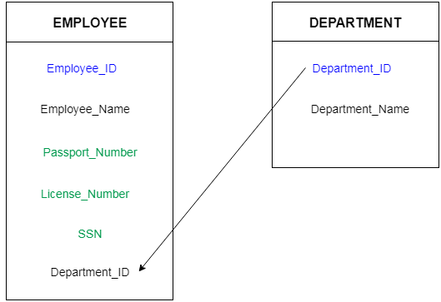
Foreign key
We add the primary key of the DEPARTMENT table, Department_Id as a new attribute in the EMPLOYEE table.
Now in the EMPLOYEE table, Department_Id is the foreign key, and both the tables are related.

Slide 62
ER Model: Keys
ALTERNATE key
All the keys which are not primary key are called an alternate key.
It is a candidate key which is currently not the primary key.
Example: Stu(sid,srollno,sfname,slname,semail)
sid, srollno, semail are qualified to become a primary key.
But since sid is the primary key, srollno and semail becomes the alternate key.

Slide 63
ER Model: Relationships
When an Entity is related to another Entity, they are said to have a relationship.
Relationship is an association among entities
Degree and Cardinality in DBMS
Degree : [No_Of_Columns in a Relation]
. Cardinality: [ No_of_Rows in a Relation]
Binary relationship : If 2 entities are involved
Ternary relationship : If 3 entities are involved

Slide 64
Relationships Types
One to One Relationship < ------- >
Many to One Relationship < ------- >
One to Many Relationship < ------- >
Many to Many Relationship < ------- >

Slide 65
Degree and Cardinality in DBMS
A table STUDENT has 5 Columns and 4 Rows
Degree: [No_Of_Columns in a Relation]
Number of attributes/columns in the relation is known as Degree of the relation.
The STUDENT relation defined above has degree 5.
Cardinality: [ No_of_Rows in a Relation]
Number of tuples/rows in a Relation is known as Cardinality.
STUDENT Relation defined above has Cardinality 4.

Slide 66
ER Diagram : ERD
ERD is a graphical tool to express graphically the overall logical structure of database.
ER model allows you to draw Database Design
It is an easy to use graphical tool for modeling data
Widely used in Database Design
It is a GUI representation of the logical structure of a Database
It helps you to identifies the entities which exist in a system and the relationships between those entities

Slide 67
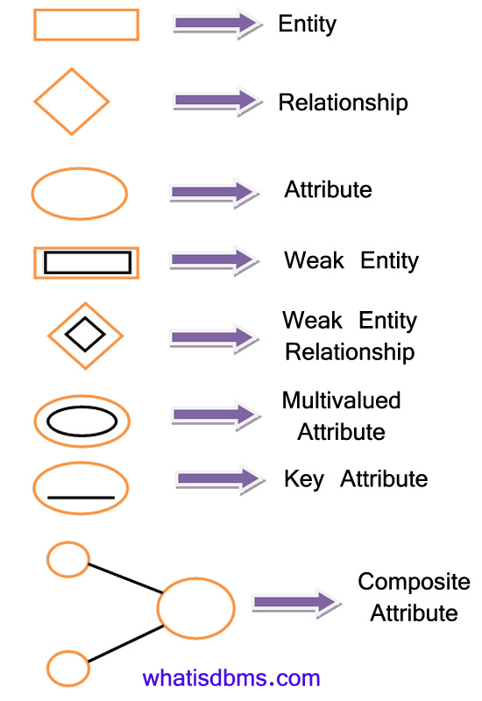
ER Diagram : Symbols

Slide 68
Strong / Weak entity set
Strong Entity Set :
This has a Primary Key Attribute
Weak Entity Set :
This do not have a Primary Key Attribute.
It can be identified uniquely by considering the primary key of another entity.
For that, weak entity sets need to have participation.

Slide 69
Extended ERD
Specialization:
Generalization:
Aggregation
Attribute Inheritance

Slide 70
Relational Algebra
Relational Algebra is a procedural query language. It consists of a set of operations that take one or
two relations as input and produce a new relation as their result.

Slide 71
Fundamental Operation in Relational Algebra are:
Selection
Projection
Union
Set Difference
Cartesian Product
Join

Slide 72
SELECTION (σ)
The SELECT operator is σ (sigma) symbol
Used as an expression to choose tuples that meet the selection condition…
σ<selection condition>(R)
-> Select operation selects tuples that satisfy a given predicate.
Ex:- find all employees living in city Pune:
^{σ} _{("city = Mumbai”)} ^{(employee)}

Slide 73
PROJECTION - (∏ ) Pi
∏ (pi) symbol used to choose attributes from a relation.
This operator shows the list of those attributes that we wish to appear in the result and rest attributes are eliminated from the table.
∏ _{<attribute list>(}relation)

Slide 74
SELECTION & PROJECTION Example
Person
Name Address
Id
Hobby
∏Name,Hobby(Person)
Name Hobby
1123
1123
5556
9876
John
John Mary Bart
123 Main
123 Main
7 Lake Dr
5 Pine St
stamps
coins hiking stamps
John
John Mary Bart
stamps
coins Hiking stamps
σ Hobby=‘stamps’(Person)
Name Address
John 123 Main
Id
Hobby
1123
stamps
9876
Bart
5 Pine St
stamps

Slide 75
UNION (U)
UNION is symbolized by ∪ , and includes all tuples that are in R or in S, eliminating duplicate tuples.
Therefore set R UNION set S would be expressed as: R U S
Using Assignment Operator (← ), it is written as
RESULT ← R ∪ S

Slide 76
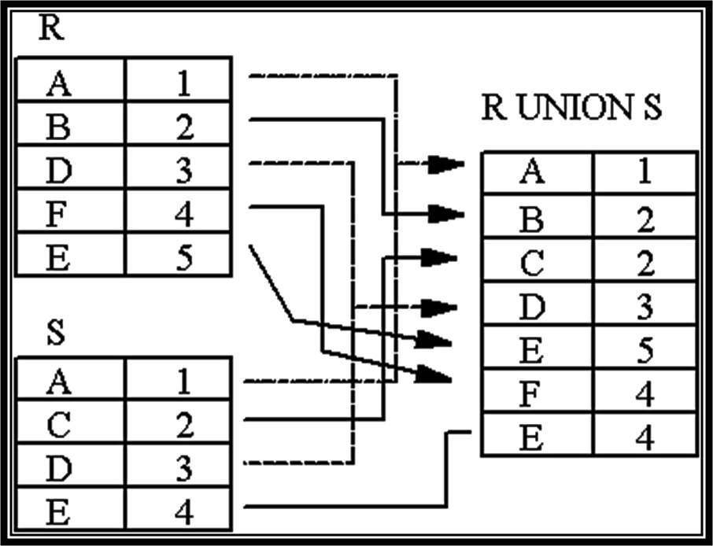
UNION Example

Slide 77
Set Difference Operator (R-S)
The MINUS operation includes tuples from one Relation that are not in another Relation. It is denoted by – (minus) symbol.
Therefore R – S would be expressed as… R-S or using Assignment opr as
RESULT ← R – S

Slide 78
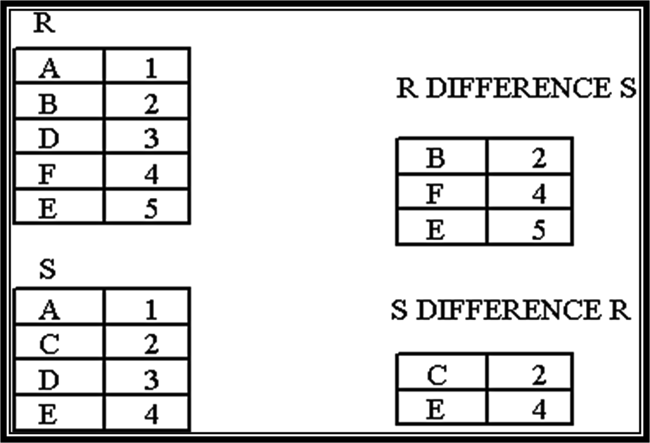
DIFFERENCE
Example
G
G

Slide 79
Intersection (∩)
The INTERSECTION operation on a relation A INTERSECTION relation B,
It is symbolized by R ∩ S, includes tuples that are only in R and S.
RESULT ← R ∩ S

Slide 80
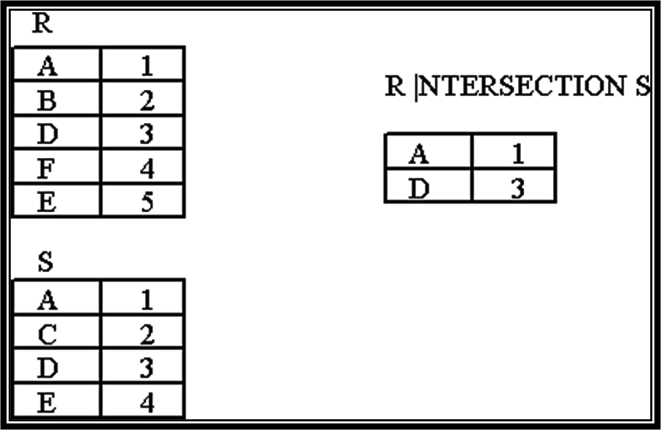
INTERSECTION
Example

Slide 81
Cartesian Product (RXS)
Creates a relation that has all the attributes of R and S, allowing all the attainable combinations of tuples from R and S in the result.
if R has ‘n’ tuples and S has ‘m’ tuples then R X S will have ‘n * m’ tuples.
The notation used is X.
C ← R X S

Slide 82
CARTESIAN PRODUCT example
A B
(Name Age Sex ) (Id Course)
------------------ -------------
Ram 14 M 1 DS
Sona 15 F 2 DBMS
kim 20 M
CARTESIAN PRODUCT OF A and B is given as A X B
Name Age Sex Id Course
----------------------------------------
Ram 14 M 1 DS
Ram 14 M 2 DBMS
Sona 15 F 1 DS
Sona 15 F 2 DBMS
Kim 20 M 1 DS
Kim 20 M 2 DBMS

Slide 83
JOINS (⋈)
The JOIN operation is denoted by the symbol R (⋈) S and is used to combine similar tuples from two Relations into single longer tuples.
Join operation is generally the cross product of two relation.
Natural join is a binary operator.
Natural join between two or more relations will result set of all combination of tuples where they have equal common attribute.

Slide 84
Natural Join
The JOIN involves an equality test, and thus is often described as an equi-join. Such joins result in two attributes in the resulting relation having exactly the same value. A `natural join' will remove the duplicate attribute(s).
In most systems a natural join will require that the attributes have the same name to identify the attribute(s) to be used in the join. This may require a renaming mechanism.
If you do use natural joins make sure that the relations do not have two attributes with the same name by accident.

Slide 85
Types of joins
Natural Join
Outer Join

Slide 86
Join/Natural Join (⋈) - Example
Emp Dept
(Name Id Dept_name ) (Dept_name Manager)
------------------------ ---------------------
A 120 IT Sale Y
B 125 HR Prod Z
C 110 Sale IT A
D 111 IT
Emp ⋈ Dept
Name Id Dept_name Manager
-------------------------------
A 120 IT A
C 110 Sale Y
D 111 IT A

Slide 87
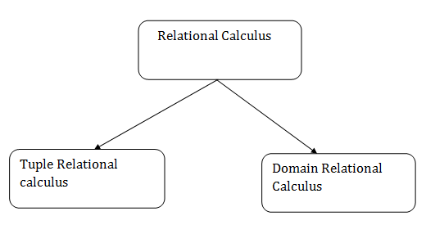
Types of Relational Calculus
The Relational Calculus has two types namely
Tuple Relational Calculus (TRC) and
Domain Relational Calculus (DRC)

Slide 88
Tuple Relational Calculus (TRC)
In the Tuple Relational Calculus, The calculus is dependent on the use of tuple variables.
A tuple variable is a variable that 'ranges over' a named relation: i.e., a variable whose only permitted values are tuples of the relation.
It is formally denoted as:
{T | P (T)} or {T | Condition (T)}
Where T is the set of tuples from which the condition P is true.

Slide 89
Examples - (TRC)
Find the staffNo, fName, lName, position, DOB, salary, and branchNo of all staff earning more than 10,000
{S | Staff(S) ∧ S.salary > 10000}
Find the tuples from the relation TEACHER in such a way that the resulting teacher tuples will have the salary greater than 20000.
{ t | TEACHER (t) and t.SALARY > 20000 }
Find the teachers who work in the dept. having Dept id 6.
{t | TEACHER (t) AND t.DEPT_ID = 6}

Slide 90
Domain Relational Calculus (DRC)
In the domain relational calculus, the variables take their values from domains of attributes rather than tuples of relations.
A domain relational calculus expression has the following general format:
{d1, d2, . . . , dn | F(d1, d2, . . . , dm)} m ≥ n
Where d1, d2, . . . , dn, . . . , dm are domain variables
and F(d1, d2, . . . , dm) is a formula.

Slide 91
Examples (DRC)
Find id, name, salary of employees who are Managers.
The DRC Query for above question is written as
{ < eid, ename, esalary > | ∈ emp ∧ epost = ‘Managers‘ }
This query will return id, name, salary of employees who hold the post as Managers.

Slide 92
Examples (DRC)
Find article, page, subject from books for the subject ‘database’
The DRC Query for above question is written as
{ < article, page, subject > | ∈ books ∧ subject = 'database‘ }
This query will return the article, page, and subject from the relation books, where the subject is a database.

Slide 93
Functional Dependencies
FDs are set of constraints on the set of legal relations
We say an attribute, B, has a functional dependency on another attribute, A, if for any two records, which have the same value for A, then the values for B in these two records must be the same.
A → B A functionally determines B
Example: We say there is a functional dependency of email address on employee number:
employee number → email address

Slide 94
Determinant/Dependent
Functional Dependency
EmpNum → EmpEmail
Attribute on the LHS is known as the Determinant
EmpNum is a determinant of EmpEmail
Attribute on the RHS is known as the Dependant
EmpEmail is dependant

Slide 95
Transitive dependency
Consider attributes A, B, and C, and where
A → B and B → C.
Functional dependencies are transitive, which means that we also have the functional dependency A → C
We say that C is transitively dependent on A through B.

Slide 96
Trivial Dependency
The dependency of an attribute on a set of attributes is known as trivial functional dependency if the set of attributes includes that attribute.
Symbolically:
A →B is trivial functional dependency if B is a subset of A.
The following dependencies are also trivial: A → A & B → B

Slide 97
Partial Dependency
A partial dependency exists when an attribute B is functionally dependent on an attribute A, and A is a component of a multipart candidate key.
Partial dependency means that a non key attribute is functionally dependent on part of a candidate key

Slide 98
Anomalies in DBMS
There are 3 types of anomalies that occur when the database is not normalized.
Insert
update
delete
emp_id | emp_name | emp_address | emp_dept

Slide 99
Update anomaly: If we want to update the address of emp that exist in many rows then we have to update the same in those rows or the data will become inconsistent. If somehow, the correct address gets updated in one place. but not in other, then emp would have different addresses, which would lead to inconsistent data.
Insert anomaly: if a new employee joins the company, and currently he not assigned to any department then we would not be able to insert the data into the table if emp_dept field doesn’t allow NULLs.
Delete anomaly: Suppose, the company closes the department D1 then deleting the rows for D1 would also delete the information of employee since emp is assigned only to this department.
To overcome these anomalies we need to normalize the data.

Slide 100
Normalization
Normalization is a process of organizing the data in database to avoid data redundancy, insertion anomaly, update anomaly & deletion anomaly.
Normalization is a process that “improves” a database design by generating relations that are of higher normal forms.
Widely used as guide in design of relational Database
It is 2 step process
Data is put into tabular form by removing repeating groups
Duplicated data is removed from relational tables

Slide 101
Objectives of Normalization
To free relations from undesirable insert update and delete anomalies
To create formal framework for analyzing relation schemas based on their keys
Reduce the need for restructuring the relations as new data types arrives.

Slide 102
Normalization
There is a sequence to normal forms:
1NF is considered the weakest,
2NF is stronger than 1NF,
3NF is stronger than 2NF, and
BCNF is considered the strongest
Also,
Any relation that is in BCNF, is in 3NF;
Any relation in 3NF is in 2NF; and
Any relation in 2NF is in 1NF.

Slide 103
Normalization
1NF
a relation in BCNF, is also in 3NF
a relation in 3NF is also in 2NF
a relation in 2NF is also in 1NF
2NF
3NF
BCNF

Slide 104
Normalization
The benefit of higher normal forms is that update semantics for the affected data are simplified.
This means that applications required to maintain the database are simpler.
A design that has a lower normal form than another design has more redundancy. Uncontrolled redundancy can lead to data integrity problems.

Slide 105
First Normal Form
We say a relation is in 1NF if all values stored in the relation are single-valued and atomic [non divisible]
1NF places restrictions on the structure of relations. Values must be simple.
As per the rule of first normal form, an attribute (column) of a table cannot hold multiple values. It should hold only atomic values.

Slide 106
Second Normal Form
A relation is in 2NF if it is in 1NF, and every non-key attribute is fully dependent on primary key. (That is, we don’t have any partial functional dependency.)
A relation in 2NF should not have any partial dependencies of any attribute on Primary Key. No Partial Dependency
A table is said to be in 2NF if the following conditions hold:
Table is in 1NF (First normal form)
No non-key attribute is dependent on the proper subset of any candidate key of table.
An attribute that is not part of any candidate key is known as non-key attribute.

Slide 107
Third Normal Form
A relation is in 3NF if the relation is in 2NF and every non-key attributes are dependent on Primary key and not transitively dependent on other attributes.
If a non key attribute functionally determines other non key attributes it is said to be transitively dependent on other non key attributes.
No Transitive Dependency
Reduces data duplication

Slide 108
BCNF
It is an advance version of 3NF that’s why it is also referred as 3.5NF.
BCNF is stricter than 3NF.
A table complies with BCNF if it is in 3NF and for every functional dependency X → Y, X should be the super key of the table.

Slide 109
Canonical Cover (Fc) :
Also called as Minimal Cover
Working with a huge set of functional dependencies can cause unnecessary added computational time. This is where the canonical cover comes into play.
A canonical cover of a set of functional dependencies F is a simplified set of functional dependencies that has the same closure as the original set F.
Focuses on to Identify and Remove extraneous attribute
Extraneous means irrelevant, not important or repetitive

Slide 110
Lossless and Lossy Decomposition in DBMS
Decomposition in DBMS removes redundancy, anomalies and inconsistencies from a database by dividing the table into multiple tables.
The following are the types:
Lossless Decomposition
Decomposition is lossless if it is feasible to reconstruct relation R from decomposed tables using Joins.
This is the preferred choice.
The information will not lose from the relation when decomposed.
The join would result in the same original relation.

Slide 111
Lossy Decomposition in DBMS
As the name suggests, when a relation is decomposed into two or more relational schemas, the loss of information is unavoidable when the original relation is retrieved.
If decomposing a relation into two or more relations, generate a loss of information, the decomposition can be termed as Lossy decomposition.
In Lossy decomposition, it is not possible to regenerate the original table through natural join as the information is lost i.e. not complete.

Slide 112
Dependency Preserving Decomposition
If we decompose a relation R into relations R1 and R2,
All dependencies of R either must be a part of R1 or R2 or
Must be derivable from combination of FD’s of R1 and R2.
For Example, A relation R (A, B, C, D) with FD set {A ->BC} is decomposed into R1(ABC) and R2(AD) which is dependency preserving because
FD A->BC is a part of R1(ABC).

